Slide 1



Business Proposal Pitch
Baby Nanny
An AI-Powered Baby Care System

Slide 2


Project Introduction
Market Analysis
01
03
CONTENTS
02
04
Team Introduction
Business Model

Slide 3
01
Team Introduction
PART ONE

Slide 4
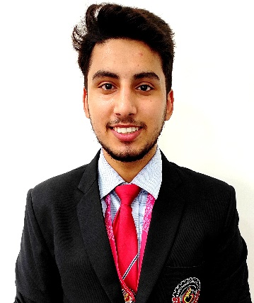
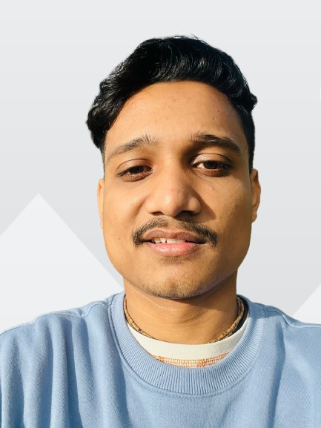

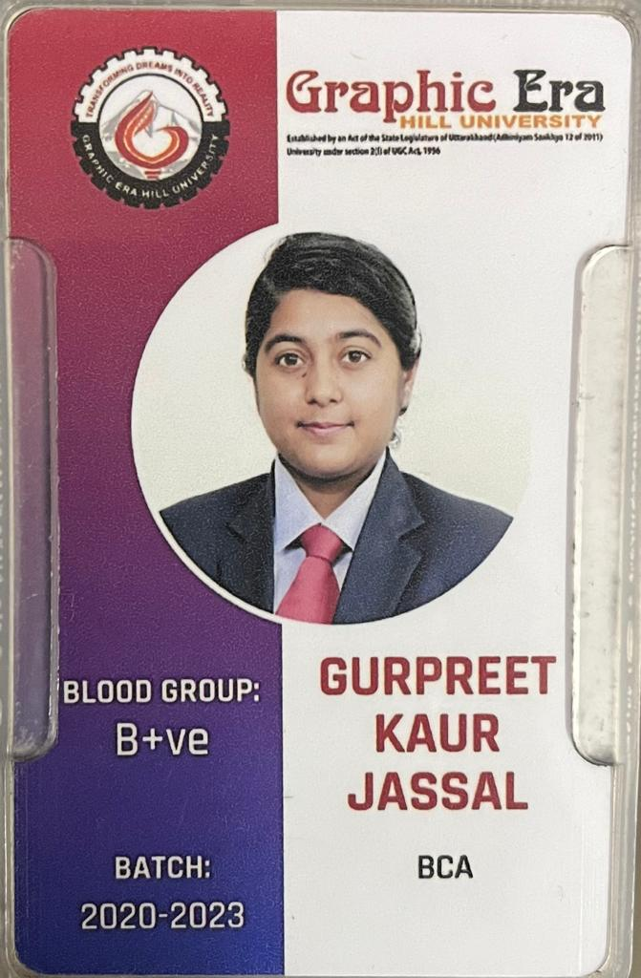

01
Team
Deepankar Sharma
Vipin Kumar
Technical Head
Executive Head
BCA,
Graphic Era Hill University With the idea and initial research, laid the foundation of the project.
BCA,
Graphic Era Hill University
Having prior hands-on work experience in various startups, currently leading the overall progress of the project.
Gurpreet Kaur Jassal
Himani Taneja
Developer
Developer
BCA,
Graphic Era Hill University
Working on mobile application development.
BSc IT,
Graphic Era Hill University
Working on the web development.

Slide 5
02
Project Introduction
PART TWO

Slide 6
02
Problem Statement and Value Proposition
Both Parents are busy/working
Single Parent
Small babies can’t say what they want
Not every parents know the best (specially first time)
Insufficient Childcare
“ Small babies don’t exactly express themselves in words, so this system is focused on identifying their needs with the help of the existing AI technology around us. ”
Prior Existing Solutions
Babysitters
Childcare Institutions
Let some relative or guardian take care
Baby Care toys (not smart enough)

Slide 7
02
Physical Structure of our Solution
We are using smart emotion detection, real-time video streaming, customized RL assistant with an implicit feedback loop.
CNN and NLP for Emotion Recognition
Community App (Advices from Others)
1
3
Hyper Personalized Reinforcement Learning based Assistant
( Learn as Child Grows )
Premium features including Smart Surveillance Intergration & Real Time Feed Monitoring
2
4

Slide 8



02
Working of the RL based Recommendation system
suppose your baby loves watching chota bheem
now model made a random decision to play Ben 10
Realtime Emotion Recognition ---> baby seems happy (positive reward for model)
The model will learn: “Your baby likes Ben 10”

Slide 9
03
Business Model
PART THREE

Slide 10
03
Implementation Plan
Timeline process
Step 02
Step 04
Introduction of freemium and premium services
End-to-End system integration.
Step 01
Step 03
Mobile application and website launch in order to build up the community.
Smart home assistance &
IOT integration.

Slide 11
03
Revenue Model
How are we going to make money ?
The service(s) will be available in freemium and various premium packages where the parents will have an opportunity to interact with the parenting community over the app and website.
The premium services will cost ~10-20K INR(depending upon the resources involved and level of customization).
Trial Period- The mobile and web app will be free to be accessed upto some extent.
Website as revenue generator- At later stages, the website will serve as an e-commerce platform for selling and buying childcare products.

Slide 12
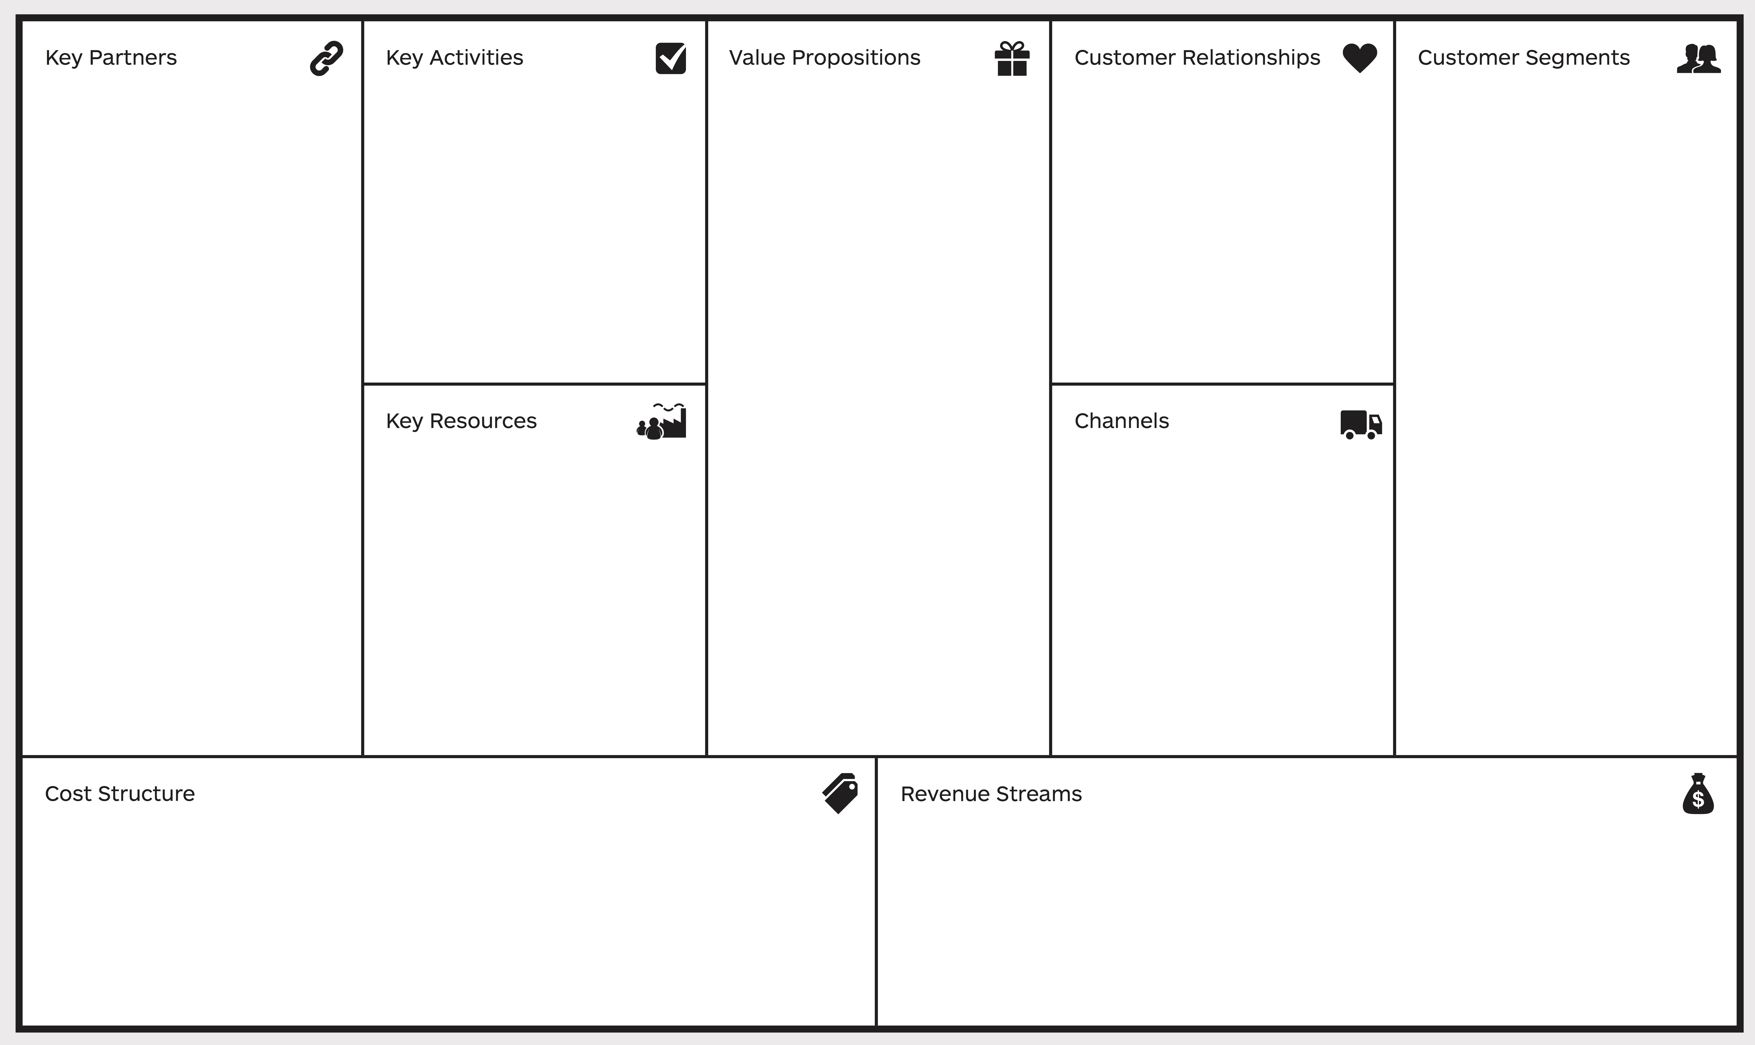
03
Business Model Canvas
community building & effective parenting
more personalized way of knowing what your child wants
customized RL enabled implicit feedback loop
Inbuilt community support in the app/website
Add ons – exquisite premium services like smart baby surveillance and real- time feed monitoring.
free app/website
freemium services
personalized RL based feedbacks
flexible premium & add ons plans
developers
single / working parents
adoption houses
general parents
childcare institutions
SEO
Social Media Advertising
Mobile App
Website
Website
Mobile App
Cloud Services
RL based Assistant
Add ons...
Infrastructure Cost (High specs systems)
Cloud Services
Staff maintenance
Marketing Cost
app / website
premium services
maintainence services
with strong community-integration into Aggregator Business Model
Opportunity cost

Slide 13
04
Market Analysis
PART FOUR

Slide 14
04
Competitive Landscape
Global Market size of Baby Care Industry sizes upto Rs. 7 Lakhs of Crores (* as per 2021)
There’s no other company working in this exact field but there are a few companies working in the subfields of our complete idea.
A few of them are – India Parenting, Parent Circle.
Our USP Advantages
Problem 1 – Parenting apps with lack of personalization.
Solution – Customized RL enabled implicit feedback loop
Problem 2 – Lack of bright parenting application/website.
Solution – Inbuilt community support in the app/website
Add ons – Exquisite premium services like smart baby surveillance and real- time feed monitoring.

Slide 15
04
Investment Objective
How much do we need!
Requirements | Cost
High-end processing devices(GPU/TPU) 2x NVIDIA RTX A6000 32 GB GPUs 16-core AMD Threadripper Pro 128 GB of system memory here | Rs. 5-6 Lakhs
Cloud Services(Amazon Kinesis for streaming) | Rs. 4.5 Lakhs @ 75000/month(as per today)
Domain/Hosting/Deployment | Rs. ~50,000
Total | Rs. 10, 00, 000

Slide 16
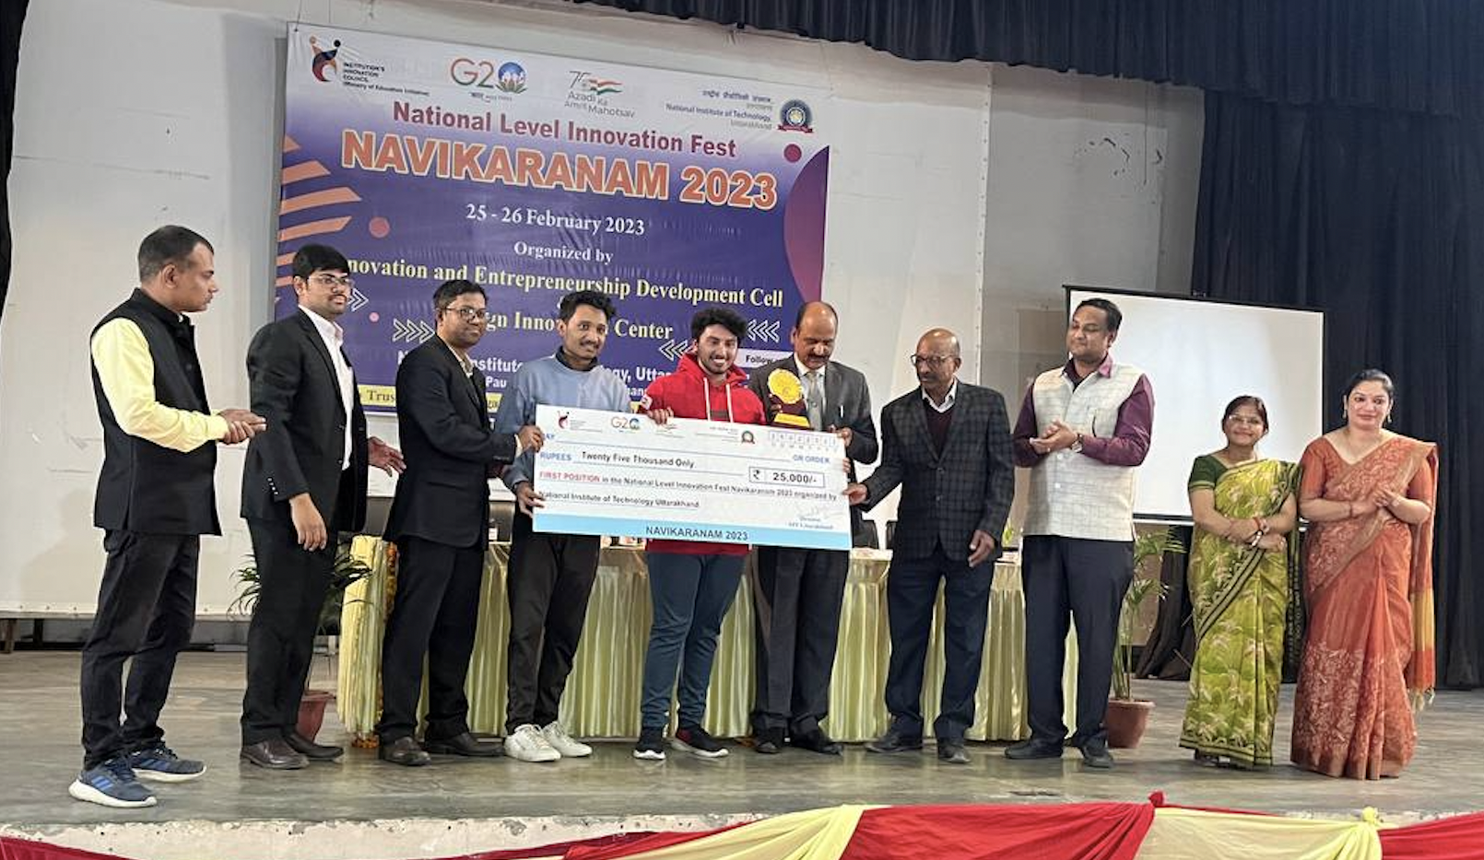
04
Milestones
Patented the idea – March 2022
Won Navikaranan’23, National Level Entrepreneurship and Innovation Fest at NIT Uttarakhand – February 2023

Slide 17
Thank You

Slide 18
Business Model Canvas
community building & effective parenting
more personalized way of knowing what your child wants
customized RL enabled implicit feedback loop
Inbuilt community support in the app/website
Add ons – exquisite premium services like smart baby surveillance and real- time feed monitoring.
free app/website
freemium services
personalized RL based feedbacks
flexible premium & add ons plans
developers
single / working parents
adoption houses
general parents
childcare institutions
SEO
Social Media Advertising
Mobile App
Website
Website
Mobile App
Cloud Services
RL based Assistant
Add ons...
Infrastructure Cost (High specs systems)
Cloud Services
Staff maintenance
Marketing Cost
app / website
premium services
maintainence services
with strong community-integration into Aggregator Business Model
Opportunity cost

Slide 19
Thank You

